Slide 1
Explainable AI(XAI)
Huawei Hong Kong Research Center
MindSpore AI & Data Team
Security Level:

Slide 2
Content
What is explainable AI (XAI)
Types of XAI methods
Attribution
Counterfactuals
Knowledge-aware XAI
Conclusion

Slide 3
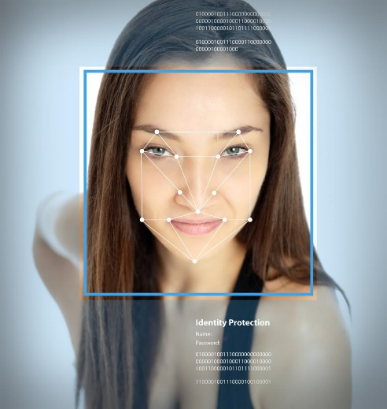

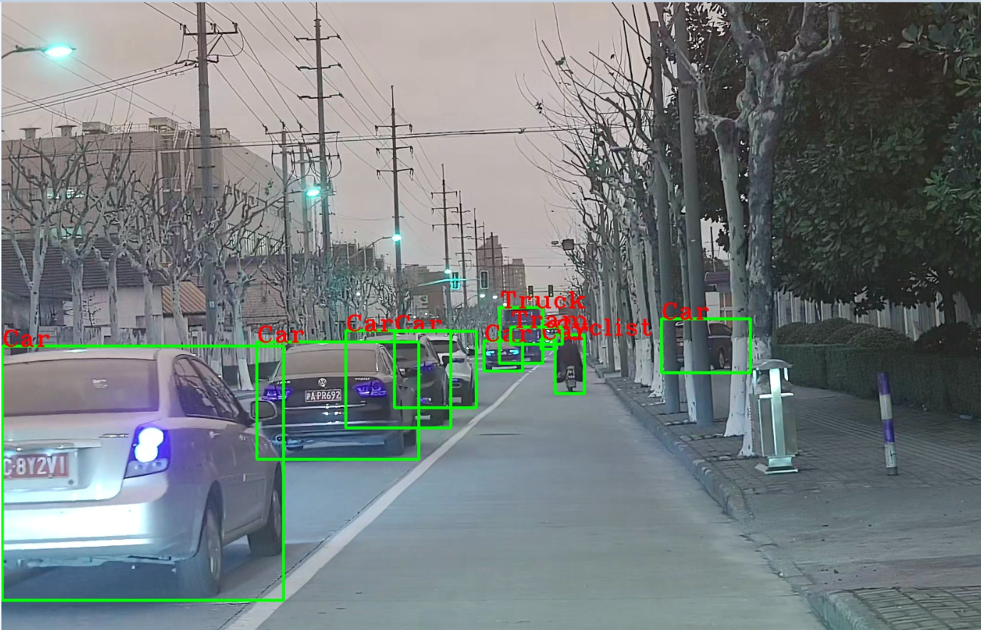

AI and deep learning scenarios
Computer vision scenario
Natural language processing scenario
Strategy board game

Slide 4
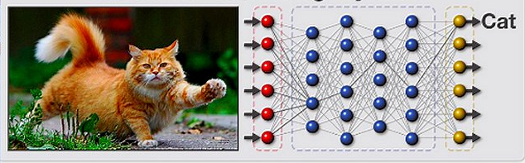
Limitation of AI: too complex to understand
Complex non-linear functions and millions of parameters in machine learning models, e.g. deep neural networks
Even designers cannot explain why the AI arrived at a specific decision
Example:
“Black boxes”: data goes in, decisions come out, but the decision making processes between input and output are intransparant.
Why cat? Why not dog?
What factors have positively/negatively affect the classifier?
When will the classifier make wrong prediction?
Source: A survey on visualization for explainable classifiers

Slide 5
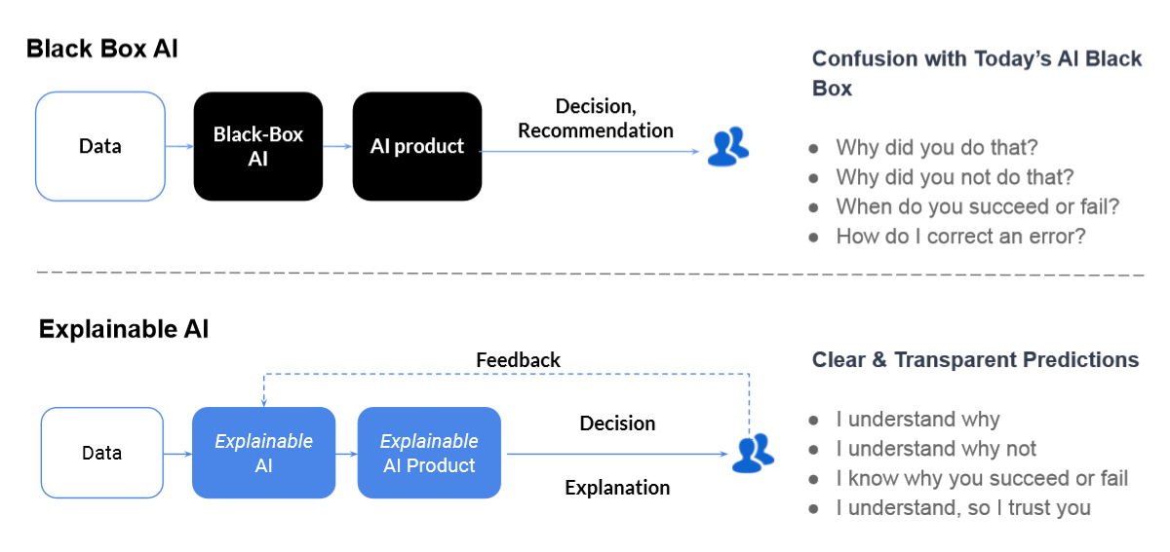
General overview of XAI
Explainable AI (XAI) refers to methods and techniques in AI such that human experts can understand the results of the solution.
- Wikipedia
Source：aaai_2020_xai_tutorial.pdf

Slide 6
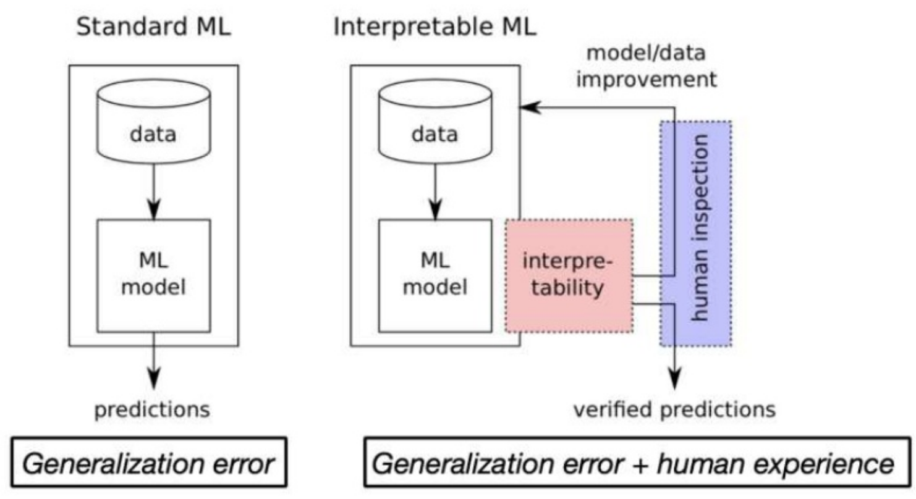
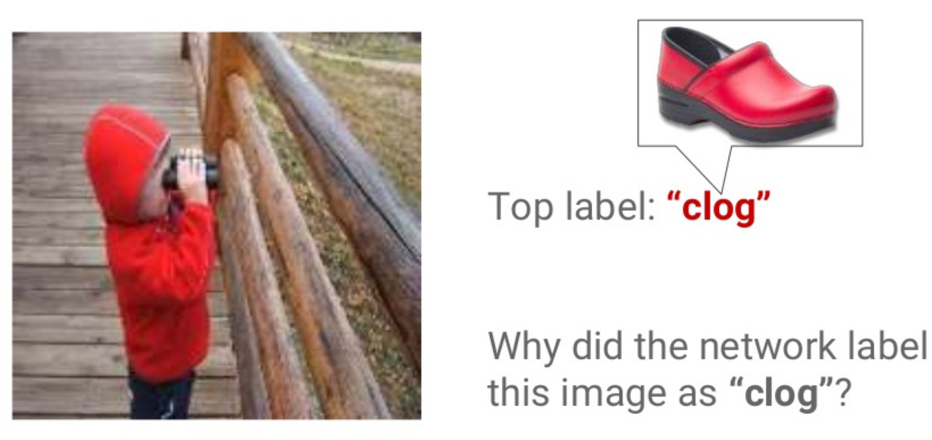
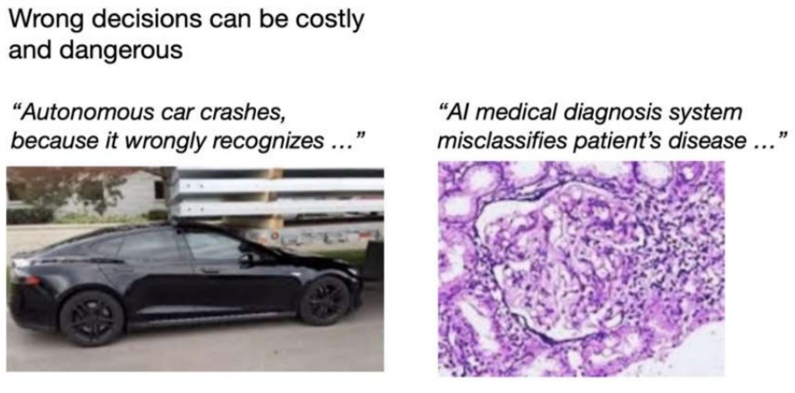

Why do we need XAI?
Debug (mis-)predictions and
Improve ML model
Trust AI service
Law against discrimination
Source： aaai_2020_xai_tutorial.pdf

Slide 7
Content
What is explainable AI (XAI)
Types of XAI methods
Attribution
Counterfactuals
Knowledge-aware XAI
Conclusion

Slide 8
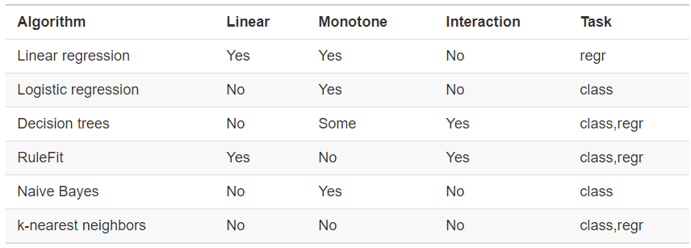
Concept of Interpretability
Interpretability and interpretable model
Generally, interpretability is the degree to which a human can understand the cause of a decision
In machine learning, a model is interpretable if its decisions are easy for a human to comprehend
Interpretability: intrinsic vs. post-hoc
Intrinsic interpretability comes from interpretable models, e.g. linear regression, decision trees, Naïve Bayes. These models are intrinsically interpretable.
Complex models, e.g. convolutional neural networks (CNNs), graph neural network (GNNs), are not interpretable. We can use XAI methods to generate post-hoc interpretability for them.
Source: Interpretable Machine Learning: A Guide for Making Black Box Models Explainable.

Slide 9
Types of XAI methods
Methods categories:
Model-specific vs. Model-agnostic
Global vs. Local
Example-based methods

Slide 10
Model-specific vs. Model-agnostic
Model-specific methods are based on the parameters of the individual models
Use intrinsic information of a model, e.g. regression weights in a linear model and gradients in a deep neural network
Same method can only work for one type of model
Model-agnostic methods are based on analyzing feature input and output pairs
Treat machine learning models as black boxes. Do not have direct access to the internal model weights or structural parameters.
Same method can be applied to any type of models
data
prediction
data
model
prediction
model
explanation
explainer
explanation

Slide 11
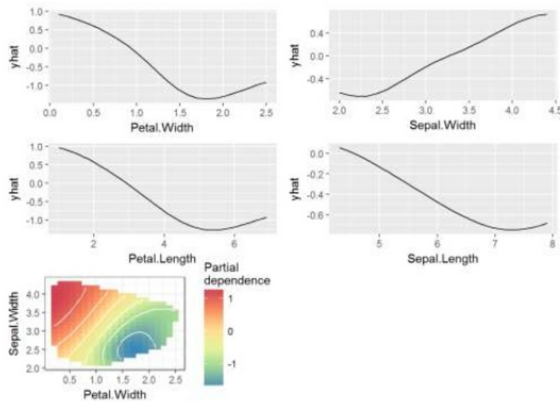
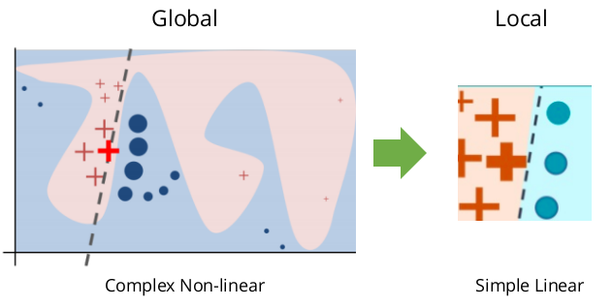
Global vs. Local
Global methods are used to explain the entire model behavior.
Typical example: Partial dependency plot (PDP). PDP visualizes the marginal effect one or two features have on the prediction of a ML model.
Local methods explain an individual prediction.
Typical example: LIME[1].
Given a data sample, LIME generates perturbations by tweaking the feature values around it.
Then, LIME trains a linear model based on the local perturbations. The linear model will be used to interpret how does each feature contribute to the prediction.
Source： aaai_2020_xai_tutorial.pdf
[1] Ribeiro M T, Singh S, Guestrin C. " Why should I trust you?" Explaining the predictions of any classifier[C]//Proceedings of the 22nd ACM SIGKDD international conference on knowledge discovery and data mining. 2016: 1135-1144.
Source: https://github.com/marcotcr/lime.
Source： aaai_2020_xai_tutorial.pdf

Slide 12
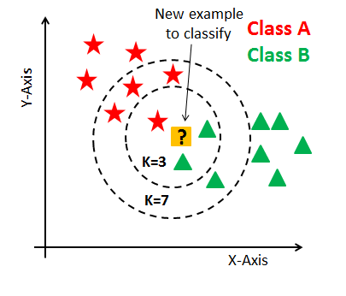
Example-based methods
How we humans think in examples?
E.g. A doctor sees a patient with an unusual cough and a mild fever. The patient's symptoms remind her of another patient she had years ago with similar symptoms. She suspects that her current patient could have the same disease and she takes a blood sample to test for this specific disease.
Thinking in examples has the form: "Thing B is similar to thing A and A caused Y, so I predict that B will cause Y as well. ”In machine learning, we can also construct mental models and think in examples to understand ML models or the underlying data distribution.
The family of example-based explanation methods:
Counterfactual explanations
Adversarial examples
Prototypes
Influential instances
k-nearest neighbors model
k-nearest neighbors model
Source： aaai_2020_xai_tutorial.pdf

Slide 13
Summary
Interpretability
Methods to interpret ML models
Model-specific v.s. Model-agnostic methods
Global v.s. Local methods
Example-based methods
References:
《Interpretable Machine Learning：A Guide for Making Black Box Models 》
Li X H, Cao C C, Shi Y, et al. A Survey of Data-driven and Knowledge-aware eXplainable AI[J]. IEEE Transactions on Knowledge and Data Engineering, 2020.

Slide 14
Content
What is explainable AI (XAI)
Types of XAI methods
Attribution
Counterfactuals
Knowledge-aware XAI
Conclusion

Slide 15
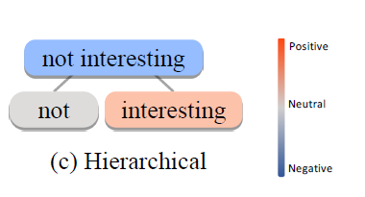
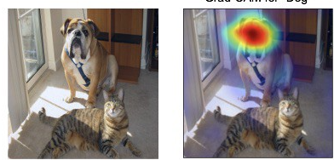
Attribution
Problem formulation: Why this prediction?
which feature of an input is responsible for the model’s output
Examples:
Image classification: Attribute the model prediction on the pixels. (shown with saliency map)
Sentiment analysis: Attribute the model prediction on the words or phrases
Saliency map
Source：Grad-CAM: Visual Explanations from Deep Networks via Gradient-based Localization, ICCV 2017
Source：Towards Hierarchical Importance Attribution: Explaining Compositional Semantics for Neural Sequence Models, ICLR 2020

Slide 16
Attribution-based methods
Methods categories:
Back-propagation methods: back-propagate signals (gradients, relevance scores) to the input as the attribution
Perturbation-based methods: perturbing the input feature and attribute the output change of the model as the attribution
This tutorial will cover the introduction of the following methods
Backpropagation based methods:
Vanilla Gradient
Guided Backpropagation
Integrated Gradients
CAM and GradCAM
Perturbation based methods:
LIME
Occlusion
RISE

Slide 17
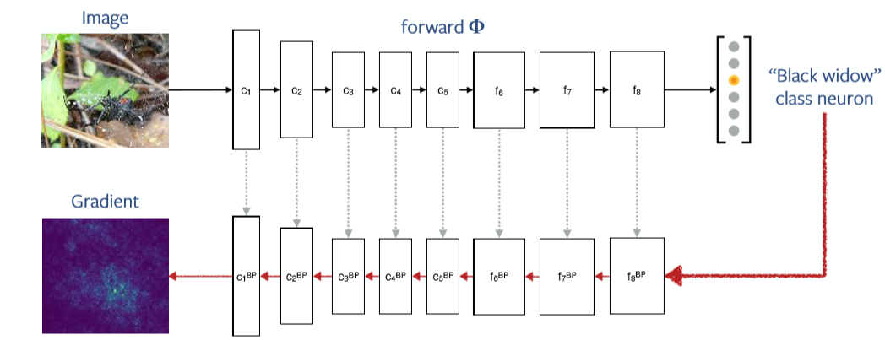

Backpropagation methods: Gradient
Gradient:
Also named as vanilla gradient
The attribution is calculated as the gradient of the output w.r.t the input
Gradient calculation:
For a deep neural network, such gradient can be obtained through backward propagation
$$S=\frac{d{Φ(I)}_{c}}{d I}$$
Source：Understanding models via visualizations and attribution, ICCV 2019 tutorial

Slide 18
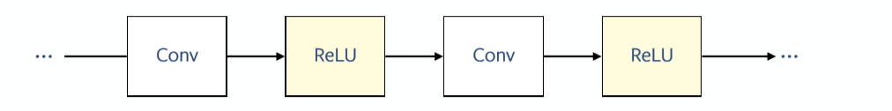
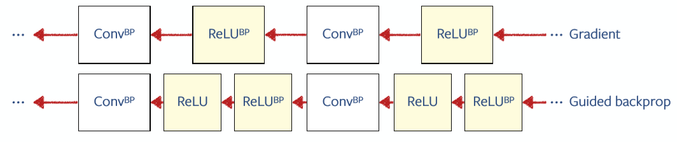
Gradient vs. guided backprogation
Guided backprop[1]:
Gradient keeps original ReLU
GuidedBackprop add ReLU for gradients to filter negative gradients
Source：Understanding models via visualizations and attribution, ICCV 2019 tutorial
[1] Springenberg J T, Dosovitskiy A, Brox T, et al. Striving for simplicity: The all convolutional net[J]. arXiv preprint arXiv:1412.6806, 2014.

Slide 19
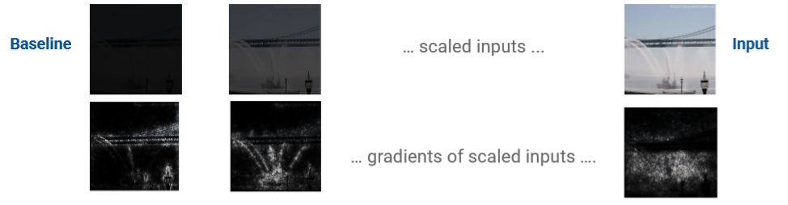
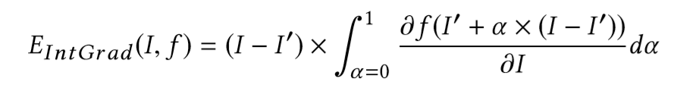
Gradient vs. Integrated Gradient
Integrated Gradient[1]:
Gradient calculation has gradient saturation issue
This method integrates the gradients along a straight-line path from baseline to input
Integrate the gradients
Source：AAAI 2020 XAI tutorial
[1] Sundararajan M, Taly A, Yan Q. Axiomatic attribution for deep networks[J]. arXiv preprint arXiv:1703.01365, 2017.

Slide 20
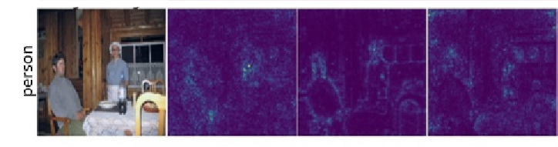
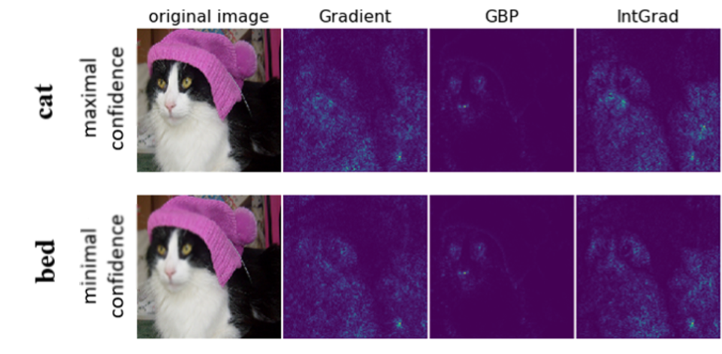
Gradient, Guided Backprop, Integrated Grad
Visual Comparisons
Lack of class sensitivity issue: Saliency maps do not change much for different labels

Slide 21
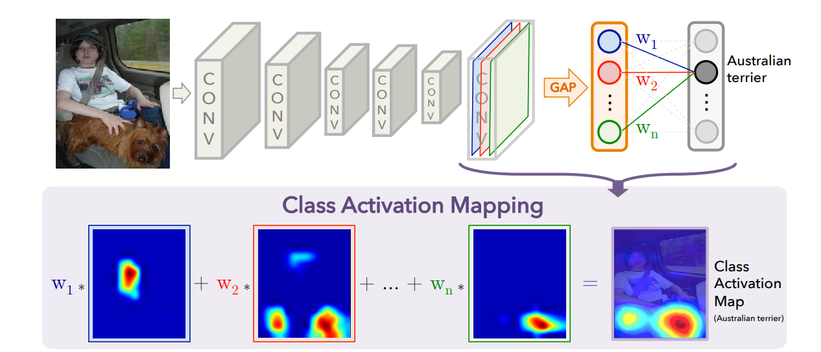
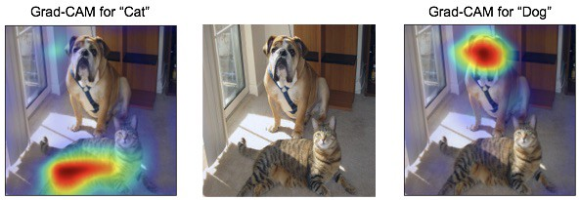
CAM and GradCAM
CAM (Class Activation Map)[1]: Generates class activation map
GradCAM[2]: relieve the restriction of CAM, can be applied to networks with FC layer
Issue: need to replace FC layer to global average pooling layer.
Weight for the class of interest
Source：Learning Deep Features for Discriminative Localization, CVPR 2016
Source：Grad-CAM: Visual Explanations from Deep Networks via Gradient-based Localization, ICCV 2017

Slide 22
Attribution
This tutorial will cover the introduction of the following methods
Backpropagation based methods:
Vanilla Gradient
Guided Backpropagation
Integrated Gradients
CAM and GradCAM
Perturbation based methods:
Occlusion
RISE

Slide 23
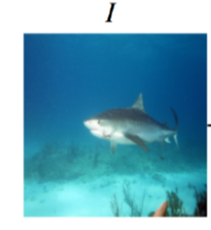
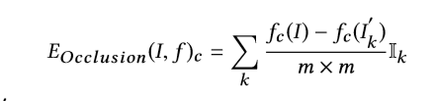
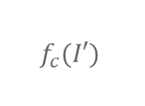
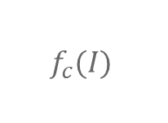
Occlusion
Simple Idea: occlusion on the original input and feed into black box model
Black-box Model f
$$f_{c}(I)$$
Differences as the attribution of the square region
Black-box Model f
$$f_{c}(I′)$$

Slide 24
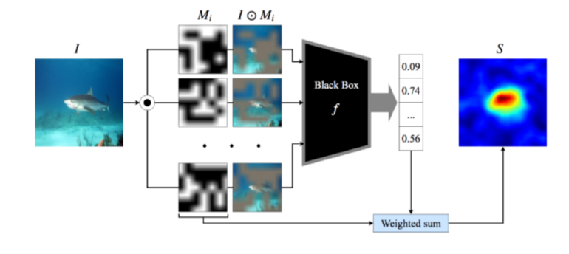
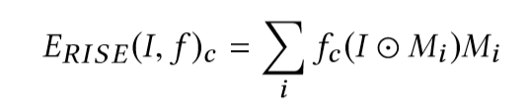
RISE: Randomized Input Sampling for Explanation
The original image is randomly masked, and then fed into the black-box model. The final saliency map is the weighted sum of these random masks.
Source：RISE: Randomized Input Sampling for Explanation of Black-box Models, BMVC 2018

Slide 25
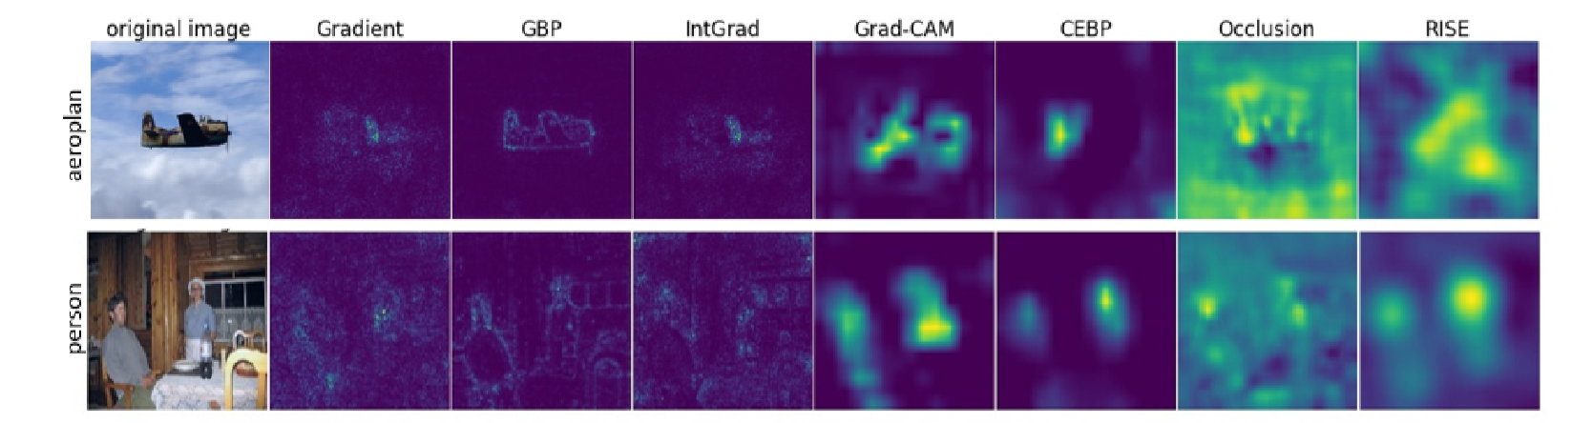
Summary: methods comparisons
Visual comparisons:
Backpropagation methods vs Perturbation Methods:
 | Backpropagation methods | Perturbation Methods
Pros | Efficient, only needs one backpropagation | Model-agnostic, truly black box models
Cons | Model-specific | Huge computation cost

Slide 26
Content
What is explainable AI (XAI)
Types of XAI methods
Attribution
Counterfactuals
Knowledge-aware XAI
Conclusion

Slide 27


Counterfactuals
Counterfactual thinking:
How the world would have to be different for a desirable outcome to occur.
Case:
Your application was denied because your annual income is $30,000 and your current balance is $200. If your income had instead been $35,000 and your current balance had been $400 and all other values remained constant, your application would have been approved.

Slide 28
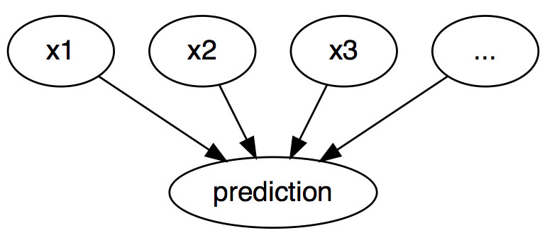
Counterfactuals in XAI
In previous case, we assume a causal relationship between the income, balance and the result.
In XAI, counterfactuals can be used to explain predictions of individual instances. The causal relationship between input and output:
The "event" is the predicted outcome of an instance
The "causes" are the particular feature values of this instance.
Passing the features to the model "caused" a certain prediction.
Generate counterfactual explanation:
Change the feature values of an instance
Make the predictions
Analyze how the prediction changes
Interpretable Machine Learning: A Guide for Making Black Box Models Explainable.

Slide 29
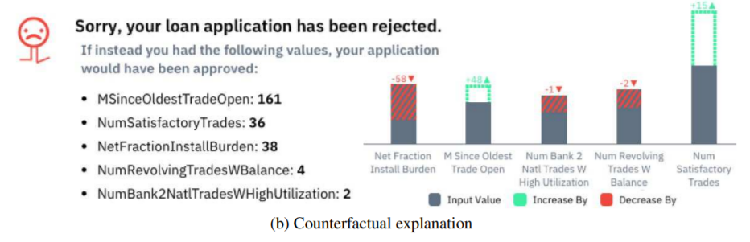
Counterfactual explanation
Toy example:
Source：Rory Mc Grath et al., “Interpretable Credit Application Predictions With Counterfactual Explanations”, https://arxiv.org/abs/1811.05245

Slide 30
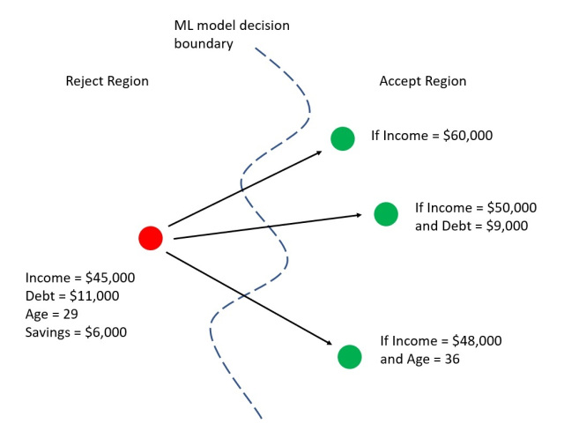
Criteria of “good” counterfactual instance
Desired prediction:
a counterfactual instance should produce the closest prediction to the desired output
Few feature changes as possible:
a counterfactual should be as similar as possible to the instance regarding feature values
Reasonable value:
a counterfactual instance should have feature values that are likely
The image illustrates three counterfactuals for a loan scenario.
Red dot: original data instance (rejected)
Green dot: counterfactual instances (accepted)
Source：https://jamesmccaffrey.wordpress.com/2020/03/23/researchers-release-open-source-counterfactual-machine-learning-library/

Slide 31
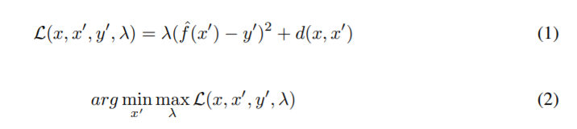
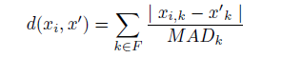
Generating Counterfactual Explanations
Problem Definition (Method by Wachter et al.)
Counterfactual can be generated by calculating the smallest possible change (∆X) that can be made to the input X, such that the outcome flips from y to y ′. It generate counterfactuals by minimizing the following loss function：
where y’ is the label for data point x’. The first term is the quadratic distance between the model prediction for the counterfactual x' and the desired outcome y', which the user must define in advance. d(x; x’) is a metric measuring the distance between the counterfactual x’ and the original data point x. λ here is to balance the distance in prediction against the distance in feature values. The distance is measured by the Manhattan distance weighted by the inverse median absolute deviation (MAD):
where F is the feature set, and MAD for feature k can be computed by:

Slide 32
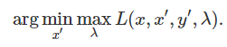
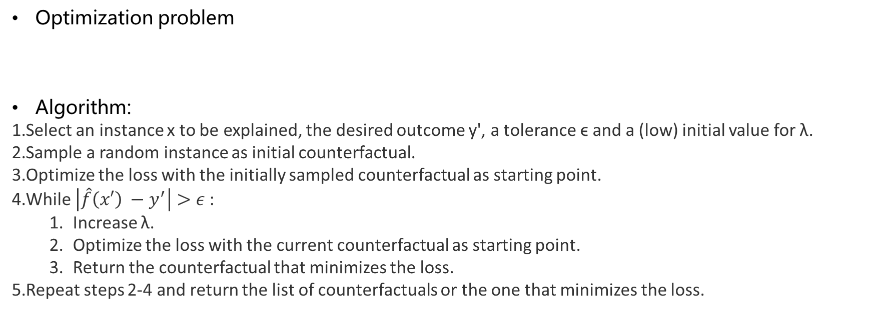
Generating Counterfactual Explanations
Optimization problem
Algorithm:
Select an instance x to be explained, the desired outcome y', a tolerance ϵ and a (low) initial value for λ.
Sample a random instance as initial counterfactual.
Optimize the loss with the initially sampled counterfactual as starting point.
While $\left|\hat{f}\left(x′\right) −y^{′}\right|>ε$:
Increase λ.
Optimize the loss with the current counterfactual as starting point.
Return the counterfactual that minimizes the loss.
Repeat steps 2-4 and return the list of counterfactuals or the one that minimizes the loss.

Slide 33
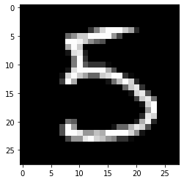
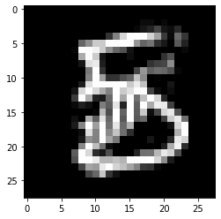
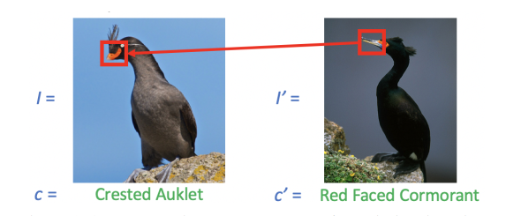
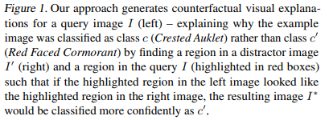
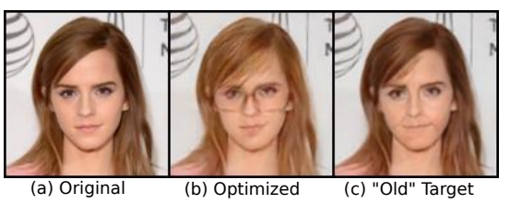
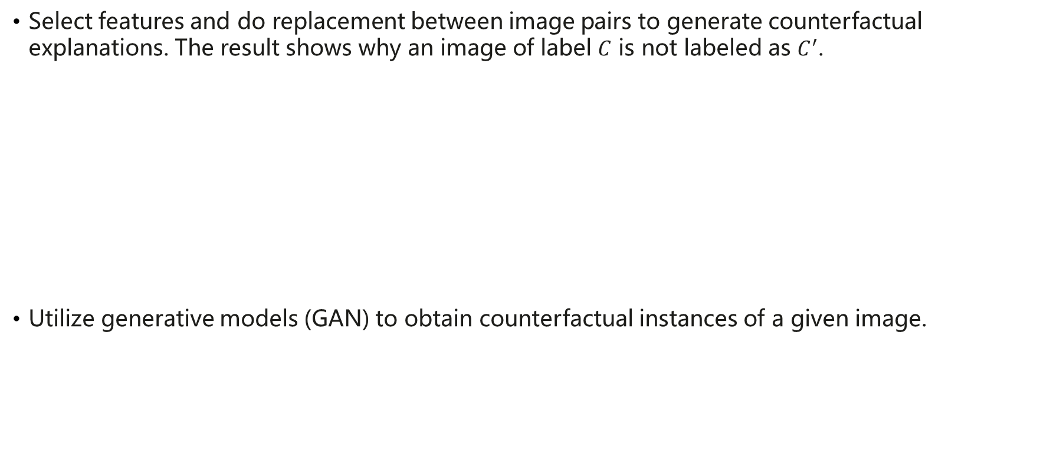
Counterfactual visual explanations
Select features and do replacement between image pairs to generate counterfactual explanations. The result shows why an image of label $C$ is not labeled as $C^{′}$.
Utilize generative models (GAN) to obtain counterfactual instances of a given image.
通过特征移植来解释为何A图片没有被分成B图片。
Source：Ruth M.J. Byrne. Counterfactuals in Explainable Artificial Intelligence: Evidence from Human Reasoning. IJCAI, 2019
Source：Yash Goyal , et al. Counterfactual Visual Explanations . ICML 2019
采用属性扰动机制，探索图片决策边界。
Illustrate different editing scheme for the input image. The original image is shown in (a).
In (c), we show the edited image that predicted as "old" by altering the "old/young" attribute of the AttGAN.
In (b), we show the modification of the same image driven by the preference of the classier (without modifying the "old/young" attribute).
Source：Liu S, Kailkhura B, Loveland D, et al. Generative counterfactual introspection for explainable deep learning[J]. arXiv preprint arXiv:1907.03077, 2019.

Slide 34
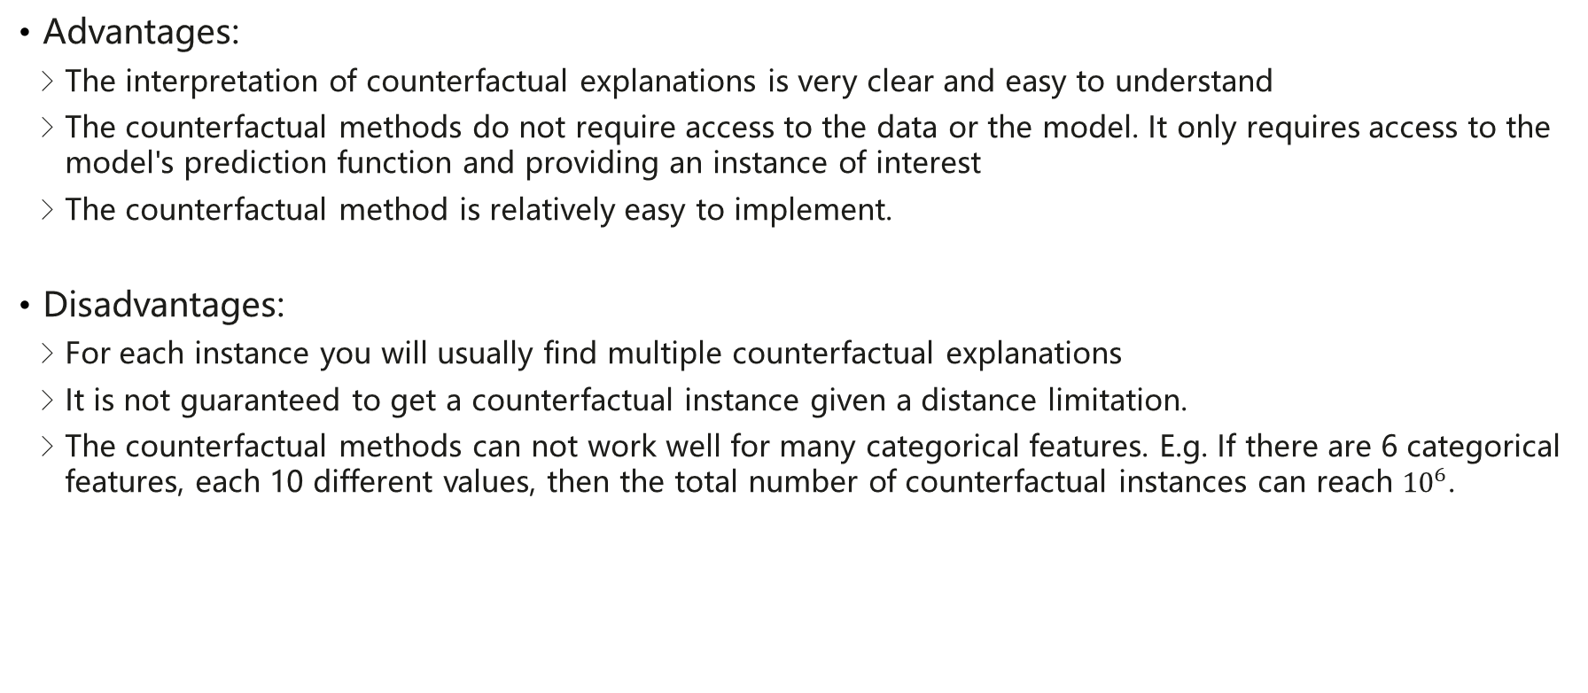
Summary: advantages and disadvantages
Advantages:
The interpretation of counterfactual explanations is very clear and easy to understand
The counterfactual methods do not require access to the data or the model. It only requires access to the model's prediction function and providing an instance of interest
The counterfactual method is relatively easy to implement.
Disadvantages:
For each instance you will usually find multiple counterfactual explanations
It is not guaranteed to get a counterfactual instance given a distance limitation.
The counterfactual methods can not work well for many categorical features. E.g. If there are 6 categorical features, each 10 different values, then the total number of counterfactual instances can reach ${10}^{6}$.

Slide 35
Content
What is explainable AI (XAI)
Types of XAI methods
Attribution
Counterfactuals
Knowledge-aware XAI
Conclusion

Slide 36
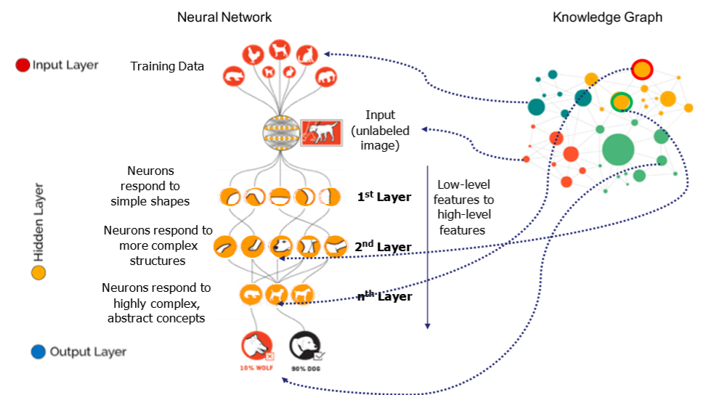
Knowledge-aware explainable AI
Data-driven methods: generate explanations from the task-related data. The explanations purely come from data, without external information such as prior knowledge (e.g., features importance, decision rules.)
Knowledge-aware methods: apply external knowledge to generate explanations. (still in an early stage)
Knowledge can be imported to the training data, input, low-level features to high-level features and output layer of a machine learning model.
Source： Freddy Lécué: On the role of knowledge graphs in explainable AI. Semantic Web 11(1): 41-51 (2020)

Slide 37
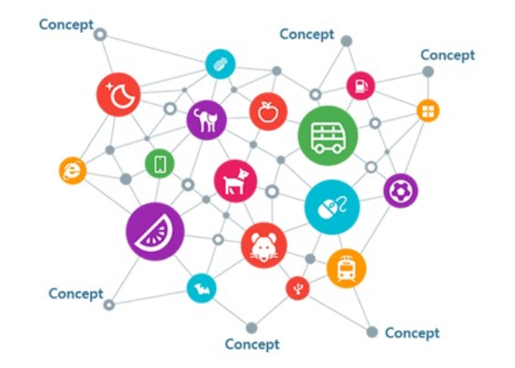
Knowledge Graph & Triples
A knowledge graph (KG) is an abstraction used in knowledge representation.
Set of triples (head, relationship, tail) – head and tail are entities, and entities are connected with relationship.
Triples denote facts, e.g. the existence of an actual relationship between two entities.
Knowledge Graph（KG）
i.e. triples（h=Beijing，r=Capital，t=China）
Represent the fact: Beijing is the Capital of China

Slide 38
What knowledge graph can do for XAI
As summarized in[1], knowledge graph can be utilized to achieve XAI in different AI fields
Machine Learning (except Neural Network): KG could be used for encoding better representation of data a more interpretable way, adopt semantic similarity for local explanation. (i.e. compact large trees in decision trees.)
Deep Neural Networks: KG could be used to capture better model hierarchical relationships. An interpretable model architecture can incorporate KG to embed causation and feature reasoning. (e.g. what is the causal relationship between the input / output / training data?)
Computer Vision: Adding semantics through context.
Constraint Satisfaction and Search: KG drives search through semantic and logical relations among constraints.
Natural Language Processing (NLP): Semantic descriptions, exposing meaningful representations, have a positive impact on tasks such as relation extraction, event extraction or text classification.
[1] Lecue F. On the role of knowledge graphs in explainable AI[J]. Semantic Web, 2019 (Preprint): 1-11.

Slide 39
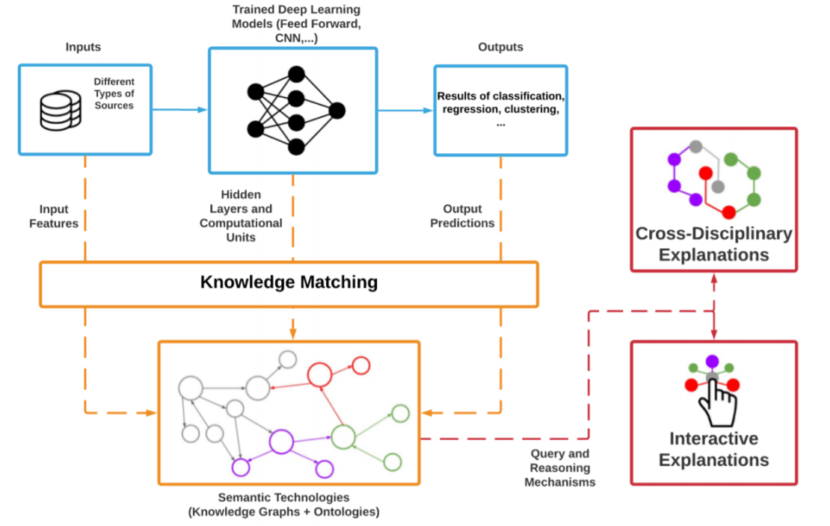
The role of knowledge graph in deep learning
As discussed in [1], KGs can provide a symbolic level to interpret the behavior and the results of a deep learning model
This image illustrate the role of knowledge graph for interpretability in deep learning. In specific,
The traditional pipeline of an AI system is depicted with the blue color.
The Knowledge Matching process can make the internal functioning of algorithms more transparent and comprehensible.
The Query and Reasoning mechanisms of KGs and ontologies enable the conditions for advanced explanations
[1] Futia, G.; Vetrò, A. On the Integration of Knowledge Graphs into Deep Learning Models for a More Comprehensible AI—Three Challenges for Future Research. Information 2020, 11, 122.

Slide 40
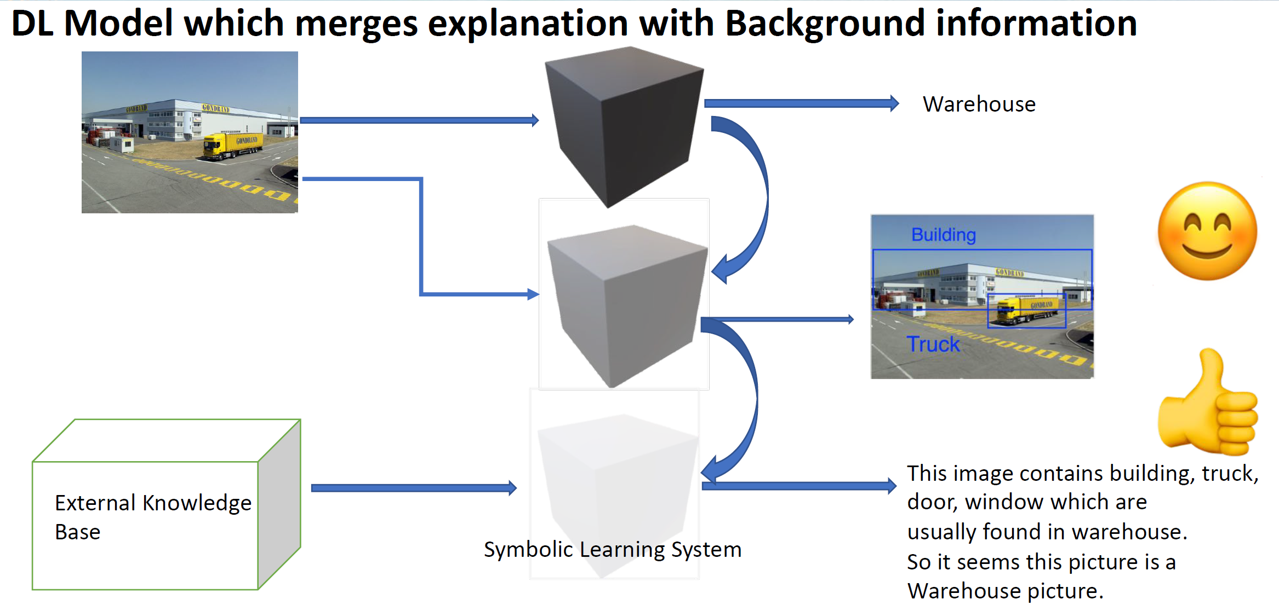
Cases: KG for XAI in deep learning
Source： Sarker MK, et al.,” Explaining Trained Neural Networks with Semantic Web Technologies: First Steps”

Slide 41
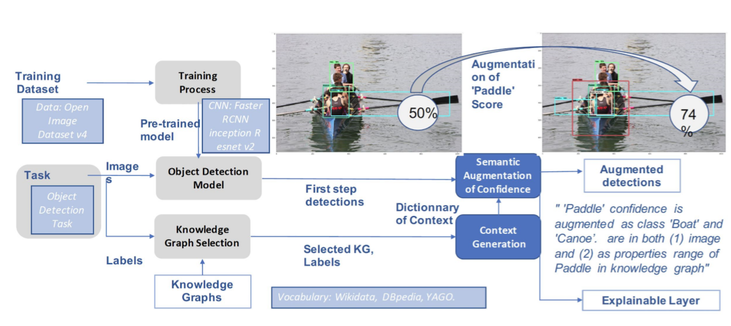
Cases: KG for XAI in deep learning
The results from baseline Faster RCNN are improved
Paddle: 50% confidence, Person: 66%, Man: 46% to
Paddle: 74% confidence, Person: 66%, Man: 56%
and with explanation: Person, Paddle, Water as part of the context in the image and kg of concept Boat.
THALES
Source：aaai_2020_xai_tutorial.pdf

Slide 42
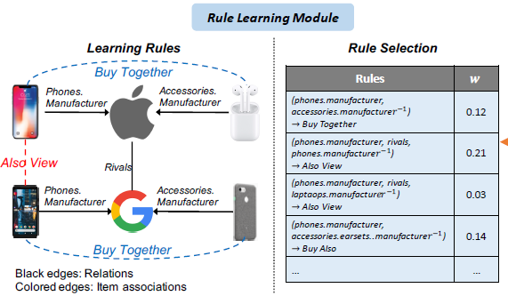
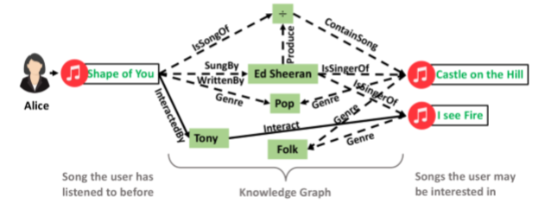
Cases: KG for XAI in Recommender systems
Rule-based
Path-based
Source：Ma W, Zhang M, Cao Y, et al. Jointly Learning Explainable Rules for Recommendation with Knowledge Graph[C]//The World Wide Web Conference. ACM, 2019: 1210-1221.
Source：Wang X, et al. 2019. Explainable Reasoning over Knowledge Graphs for Recommendation. In AAAI.

Slide 43
Content
What is explainable AI (XAI)
Types of XAI methods
Attribution
Counterfactual
Knowledge-aware XAI
Conclusion

Slide 44
Conclusion
What is XAI?
Types of XAI techniques
Attribution-based methods
Counterfactual explanation
Knowledge-aware XAI

Slide 45
About us
Huawei Hong Kong Research Center
Huawei is establishing the Hong Kong Research Center with focus on CPU, Basic Software, AI related research and development, from algorithm, software to chip set development.
MindSpore AI & Data Team
This team contributes to Huawei’s newly released deep learning framework MindSpore, focusing on the innovative research and development of interpretable deep learning, data fairness, algorithmic ethics and so on.
We are hiring!
AI & Data Researcher
Research Intern
Please send your full resume to choi.man@huawei.com

